Slide 1
Analysis of micro-instabilities impact on the electron temperature gradient length in NSTX pedestals
Presenter: Max T. Curie
Galina Avdeeva, Jason Parisi, Gary Staebler, David R. Hatch, Stefano Munaretto, Sterling Smith, Walter Guttenfelder, Mate Lampert, Oak Nelson, Tom Neiser, Joel Larakers, Stanley Kaye, Eric Fredrickson, Ahmed Diallo, Ehab Hassan, Michael Halfmoon, Joshua M Manela, Matthew M Tennery, NSTX team

Slide 2
Overview
Motivation
Approach
Results
Future works

Slide 3
Motivation

Slide 4
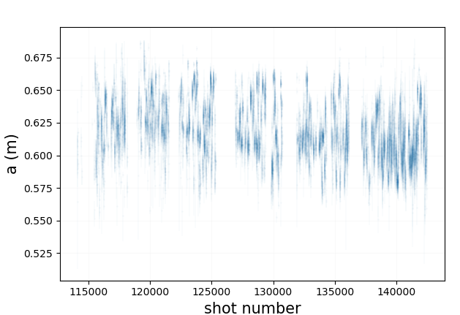
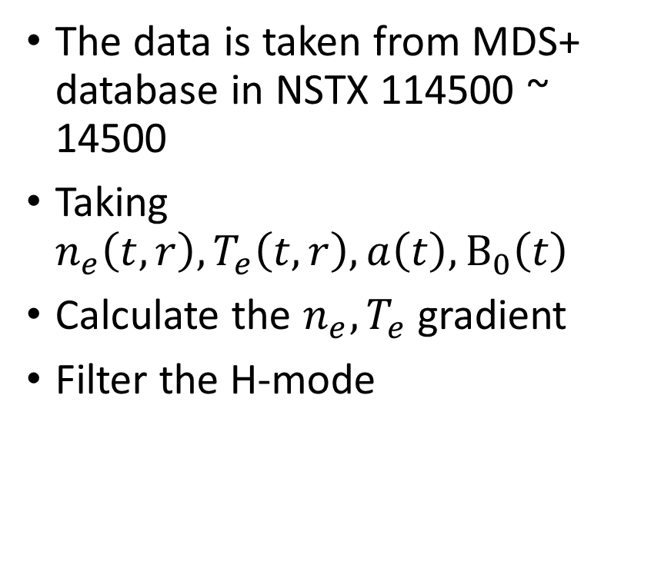
Data acquisition
The data is taken from MDS+ database in NSTX 114500 ~ 14500
Taking $n_{e}\left(t,r\right), T_{e}\left(t,r\right),a\left(t\right),B_{0}\left(t\right)$
Calculate the $n_{e},T_{e}$ gradient
Filter the H-mode

Slide 5
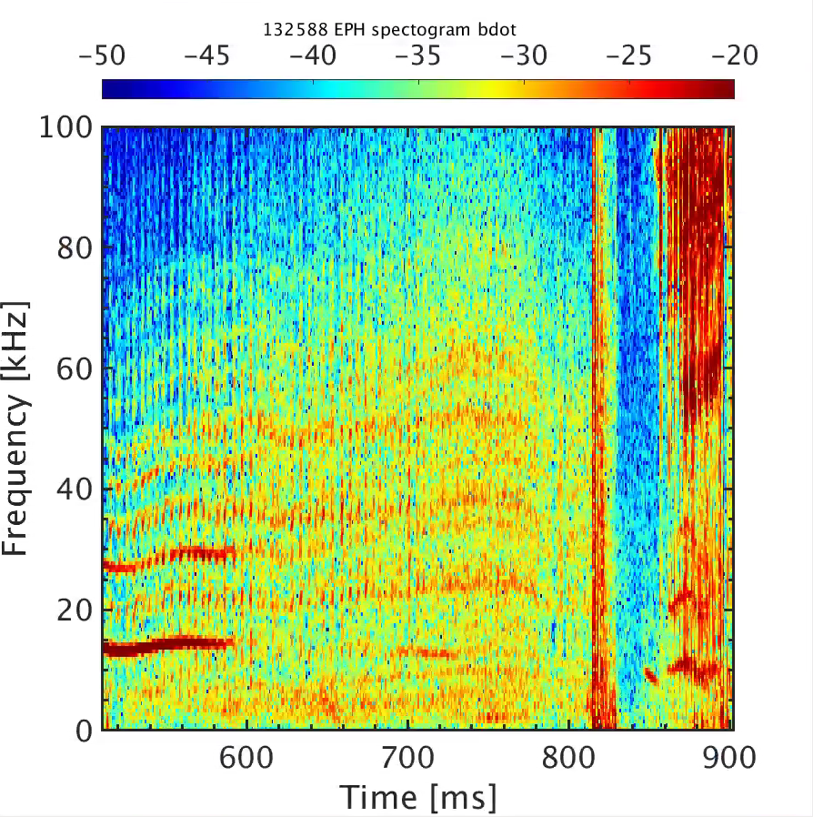
Example – NSTX 132588
b

Slide 6
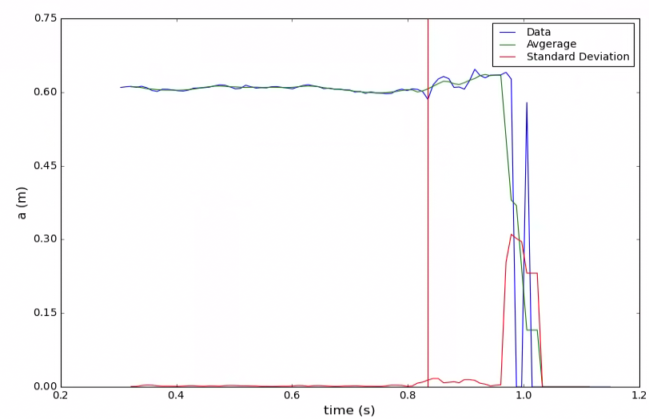
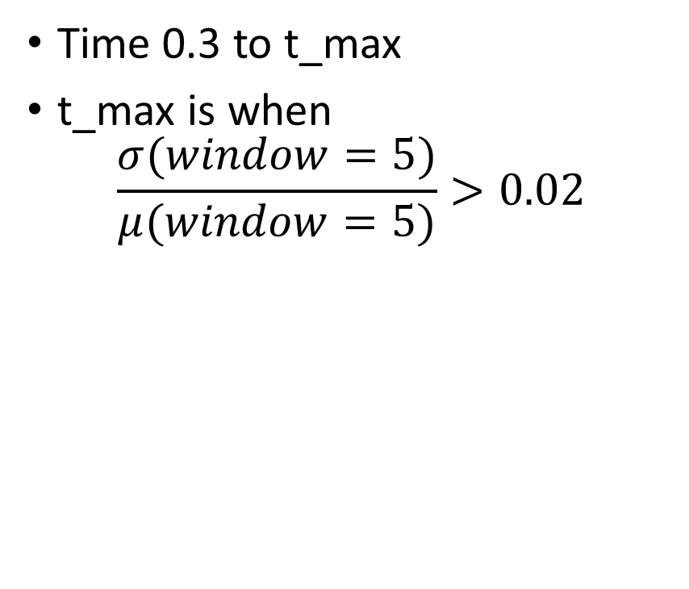
Cut off for time
Time 0.3 to t_max
t_max is when
$$\frac{σ(window=5)}{μ(window=5)}>0.02$$

Slide 7
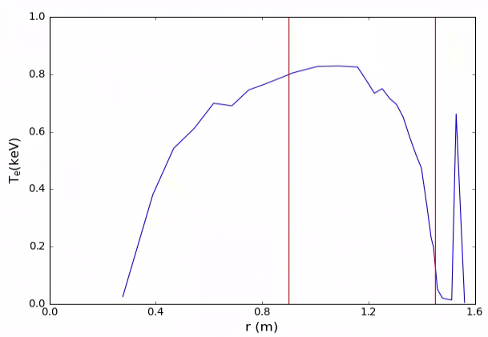
Cut off for R
R is 0.9 ~ 1.45

Slide 8
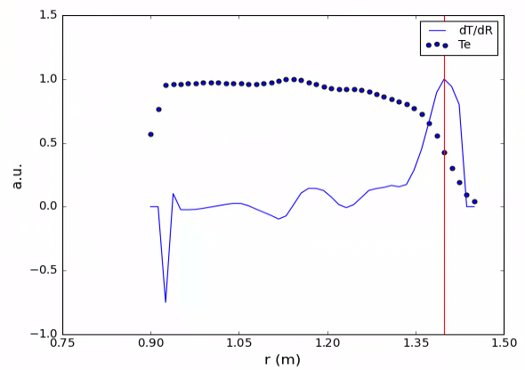
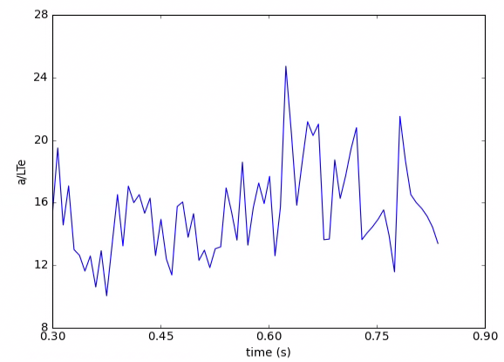
Finding pedestal
Take gradient and find the max

Slide 9
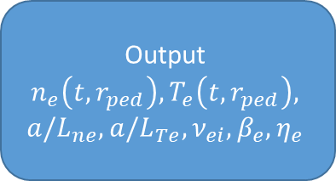
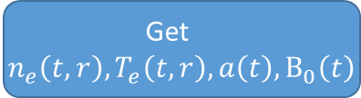
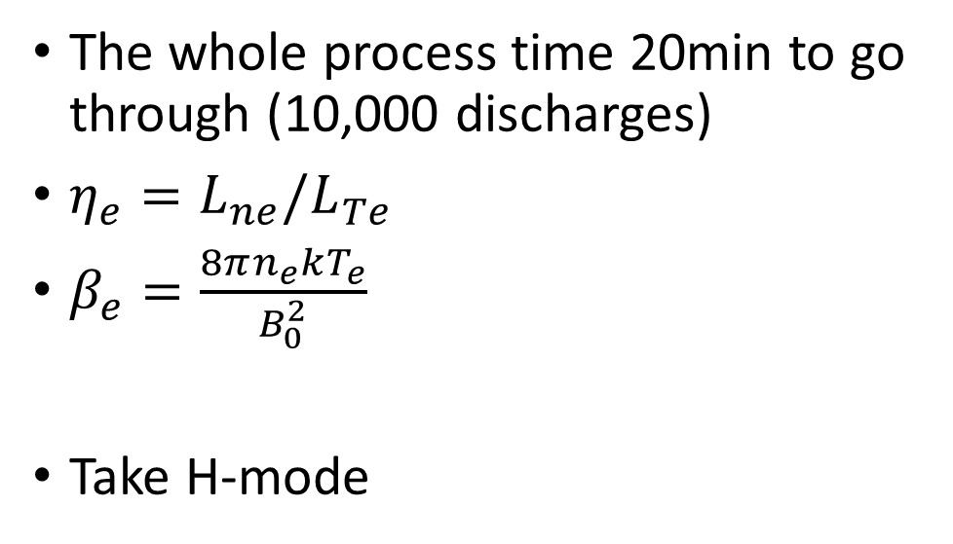

Work flow
Discharge
Get
$n_{e}\left(t,r\right), T_{e}\left(t,r\right),a\left(t\right),B_{0}\left(t\right)$
The whole process time 20min to go through (10,000 discharges)
$η_{e}={L_{ne}/L}_{Te}$
$β_{e}=\frac{8πn_{e}kT_{e}}{B_{0}^{2}}$
Take H-mode
Cut R 0.9 ~ 1.45m
Choose the plateau time
Interpolate the time and radius to uniform coordinate
0.05s/shot
Calculate the
dn/dR, dT/dR
Find pedestal $r_{ped}$
Output
$$n_{e}\left(t,r_{ped}\right),T_{e}\left(t,r_{ped}\right),$$
$${a/L}_{ne},{a/L}_{Te}, ν_{ei}, β_{e}, η_{e}$$
Filter out the unusable data

Slide 10
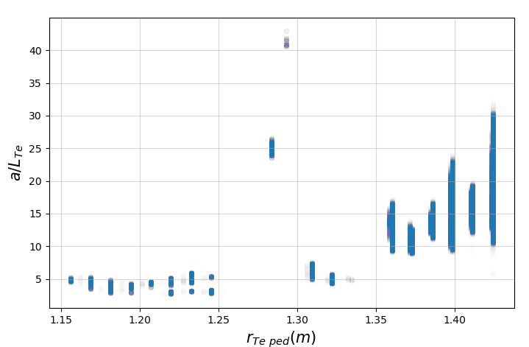
Spotting H-mode

Slide 11
Spotting H-mode

Slide 12
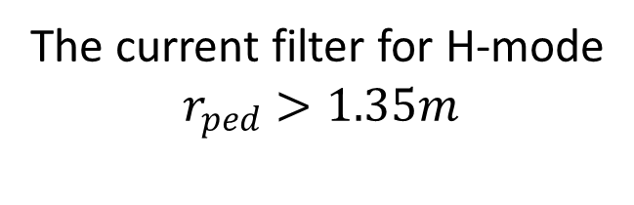
Spotting H-mode
The current filter for H-mode
$$r_{ped}>1.35m$$

Slide 13
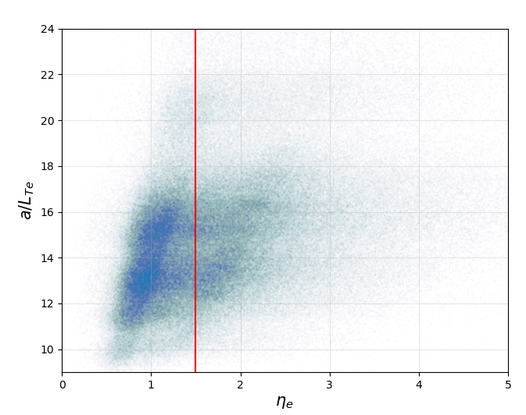
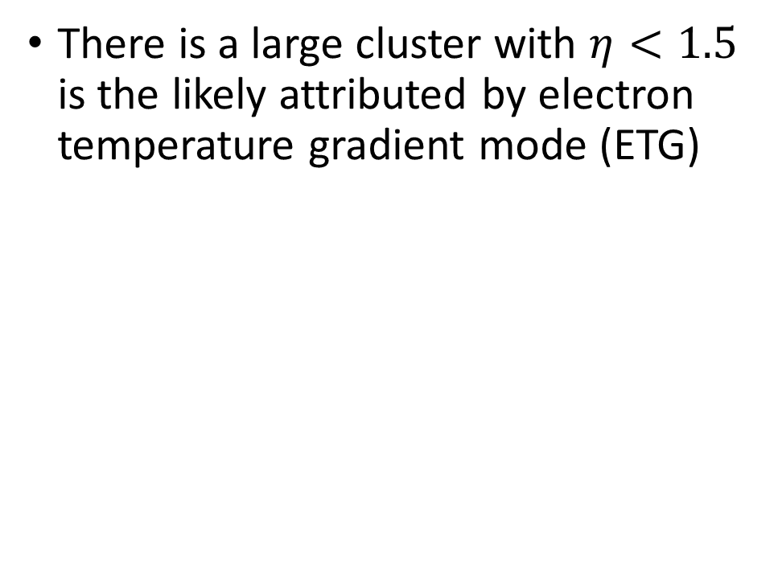
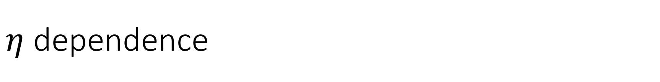
$η$ dependence
There is a large cluster with $η<1.5$ is the likely attributed by electron temperature gradient mode (ETG)

Slide 14
$η$ dependence
There is a large cluster with $η<1.5$ is the likely attributed by electron temperature gradient mode (ETG)

Slide 16
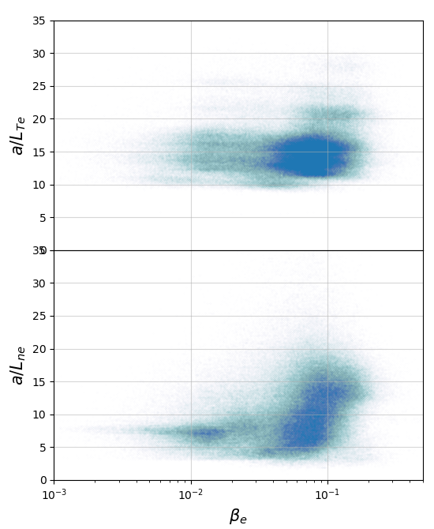
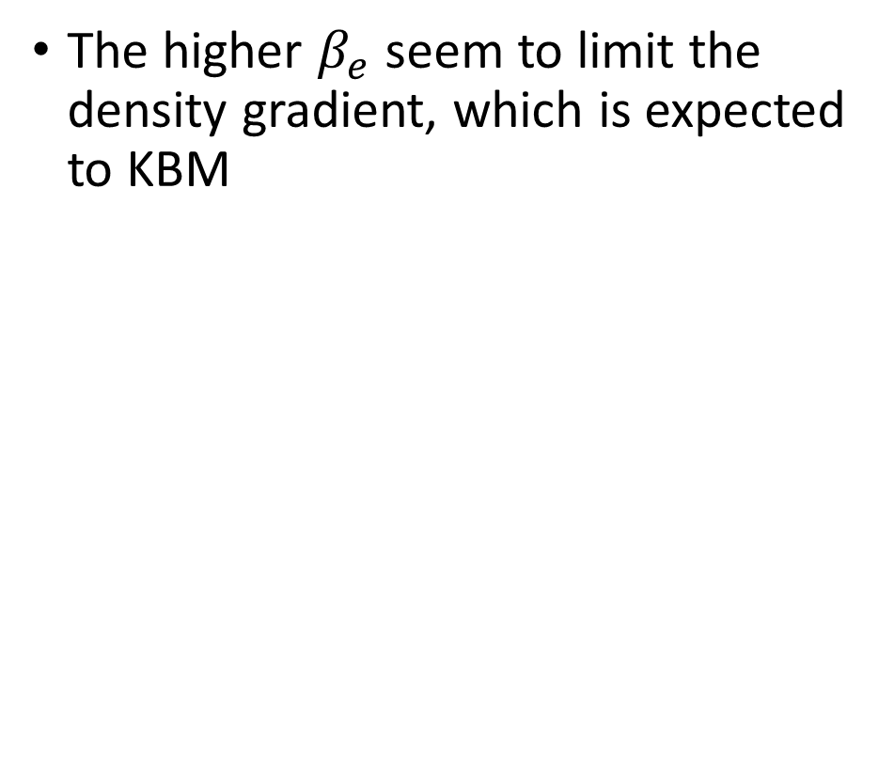
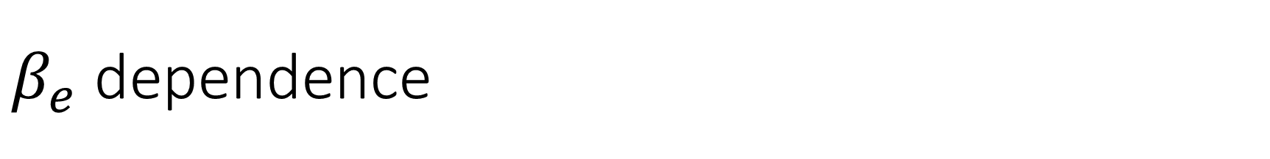
$β_{e}$ dependence
The higher $β_{e}$ seem to limit the density gradient, which is expected to KBM

Slide 17
$β_{e}$ dependence
The higher $β_{e}$ seem to limit the density gradient, which is expected to KBM

Slide 18
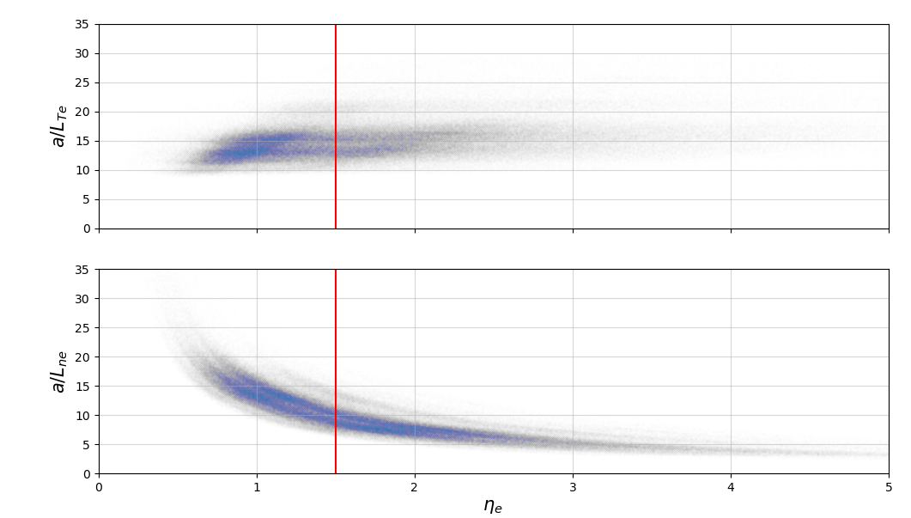
$β_{e}$ dependence
The higher $β_{e}$ seem to limit the density gradient, which is expected to KBM

Slide 19
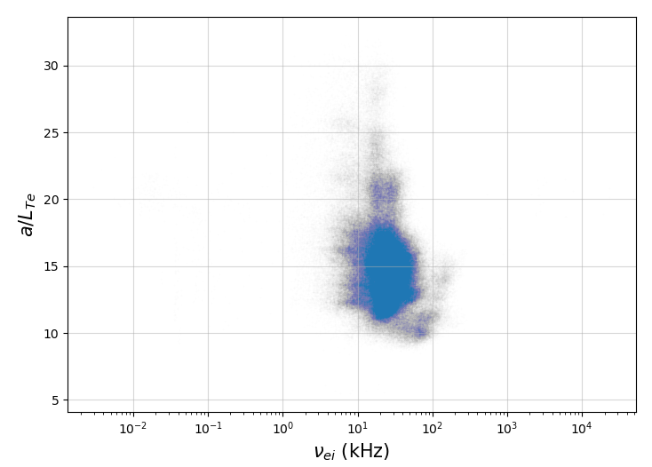
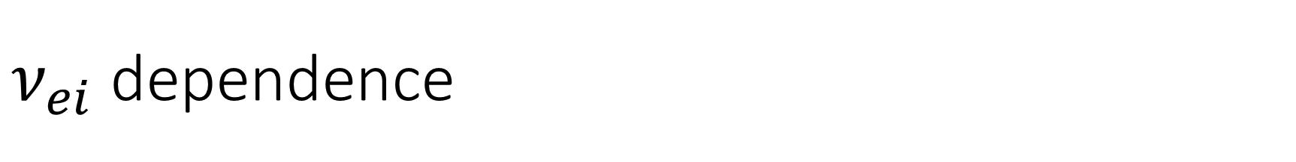
$ν_{ei}$ dependence

Slide 20
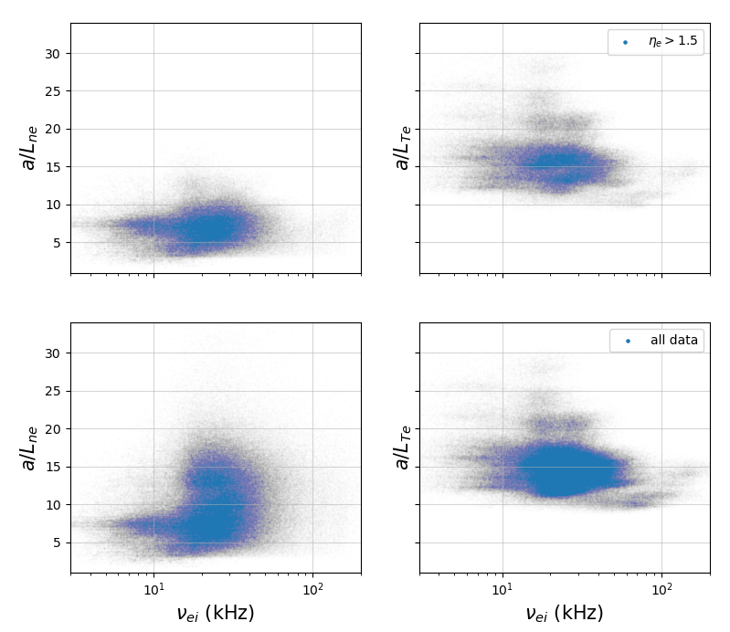
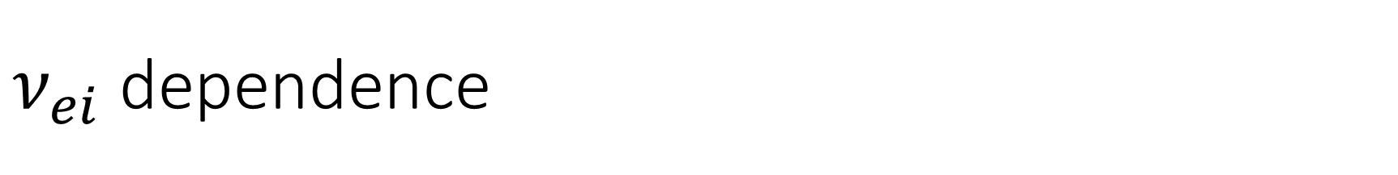
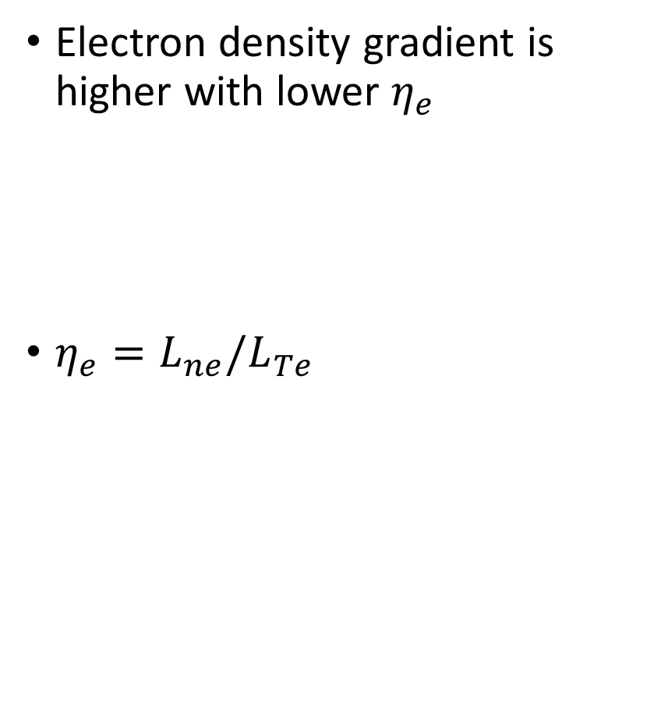
$ν_{ei}$ dependence
Electron density gradient is higher with lower $η_{e}$
$η_{e}={L_{ne}/L}_{Te}$

Slide 21
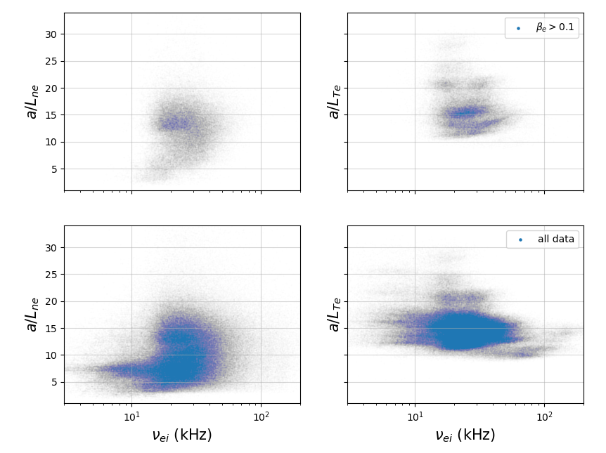

Slide 22
Backup

Slide 23
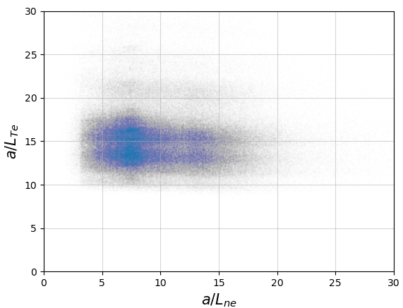

Slide 24
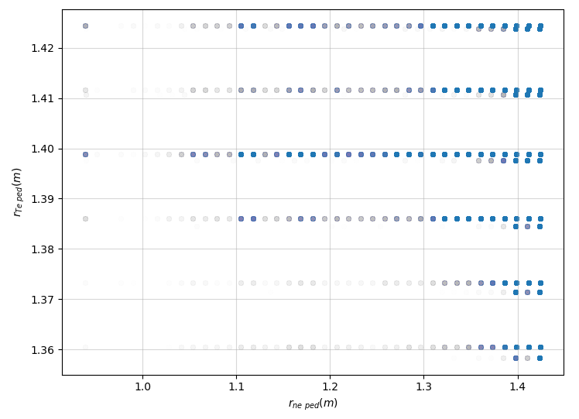

Slide 25
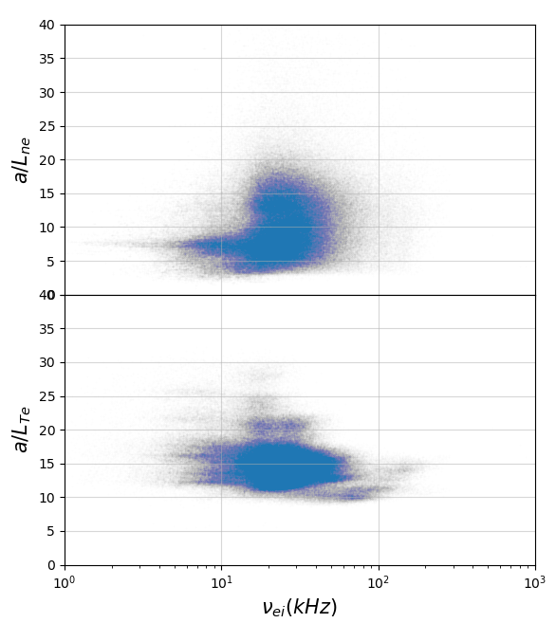
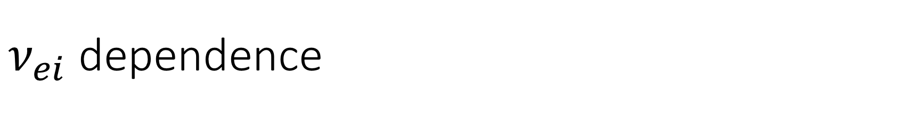
$ν_{ei}$ dependence

Slide 26
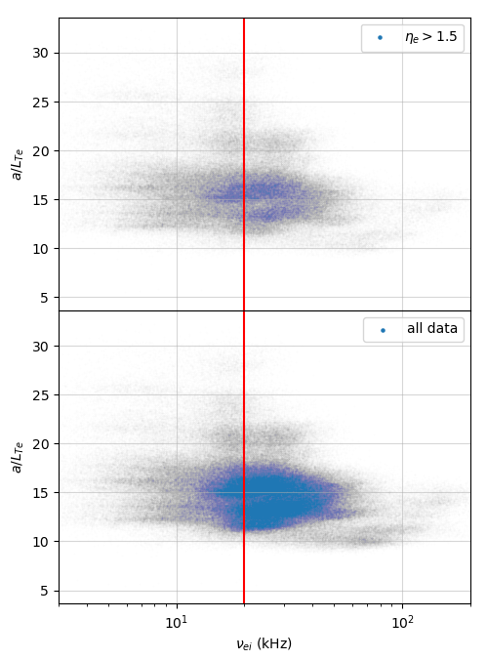
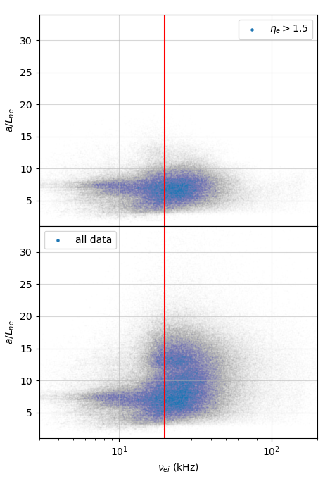
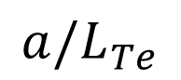
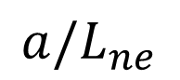
$$a/L_{Te}$$
$${a/L}_{ne}$$

Slide 27
